Slide 1
Behavior Design Pattern (2)
Parinya Ekparinya
Parinya.Ek@kmitl.ac.th
Software Architecture and Design

Slide 2
Acknowledgement
The content of the following slides are partially based on the listed material as follows:
Object-Oriented Patterns & Frameworks by Dr. Douglas C. Schmidt
https://en.wikipedia.org/wiki/Command_pattern
https://en.wikipedia.org/wiki/Strategy_pattern
https://en.wikipedia.org/wiki/State_pattern
https://en.wikipedia.org/wiki/Template_method_pattern
https://en.wikipedia.org/wiki/Visitor_pattern

Slide 3
WARNING: Overuse of design patterns can lead to code that is downright over-engineered. Always go with the simplest solution that does the job and introduce patterns only where the need emerges.
Freeman, E., Robson, E., Bates, B., & Sierra, K. (2008). Head first design patterns. " O'Reilly Media, Inc."

Slide 4
Behavior Design Patterns
Iterator
Observer
Mediator
Interpreter
Null Object
Command
Strategy
State
Template Method
Visitor

Slide 5



Command
Also known as:
Action, Transaction

Slide 6
Command: Problem
Coupling the invoker of a request to a particular request should be avoided. That is, hard-wired requests should be avoided.
It should be possible to configure an object (that invokes a request) with a request.
Applicability
To parameterize objects with an action to perform
To specify, queue, & execute requests at different times
For multilevel undo/redo.

Slide 7
Command: Solution
Intent
Encapsulate the request for a service.
Using the command design pattern describes the following solution:
Define separate (command) objects that encapsulate a request.
A class delegates a request to a command object instead of implementing a particular request directly.

Slide 8
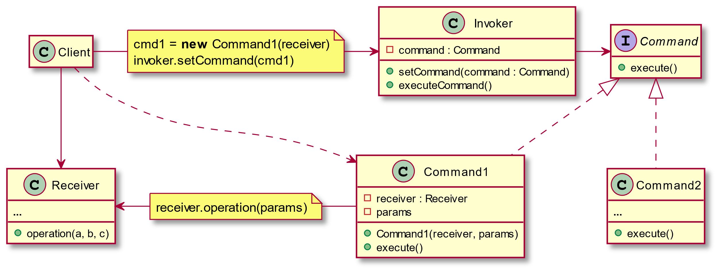

Slide 9
List of Commands = Execution History
unexecute()
execute()
unexecute()
unexecute()
Undo:
cmd
cmd
Redo:
cmd
cmd
past
future
past
future

Slide 10
Command: Consequences
Abstracts executor of a service.
Supports arbitrary-level undo-redo.
Composition yields macro-commands.
Might result in lots of trivial command subclasses.
Excessive memory may be needed to support undo/redo operations.

Slide 11
Command: Examples
Command (refactoring.guru)
Command pattern – Wikipedia
Command Design Pattern – JournalDev

Slide 12

Strategy

Slide 13
Strategy: Problem
How to independently vary algorithm from clients that use it?
How to defer the decision about which algorithm to use until runtime?
Applicability
when an object should be configurable with one of many algorithms,
and all algorithms can be encapsulated,
and one interface covers all encapsulations

Slide 14
Strategy: Solution
Intent
Define a family of algorithms, encapsulate each one, & make them interchangeable to let clients & algorithms vary independently.
What solution does the Strategy design pattern describe?
Define a family of algorithms, encapsulate each one, and make them interchangeable.
Strategy lets the algorithm vary independently from clients that use it.

Slide 15
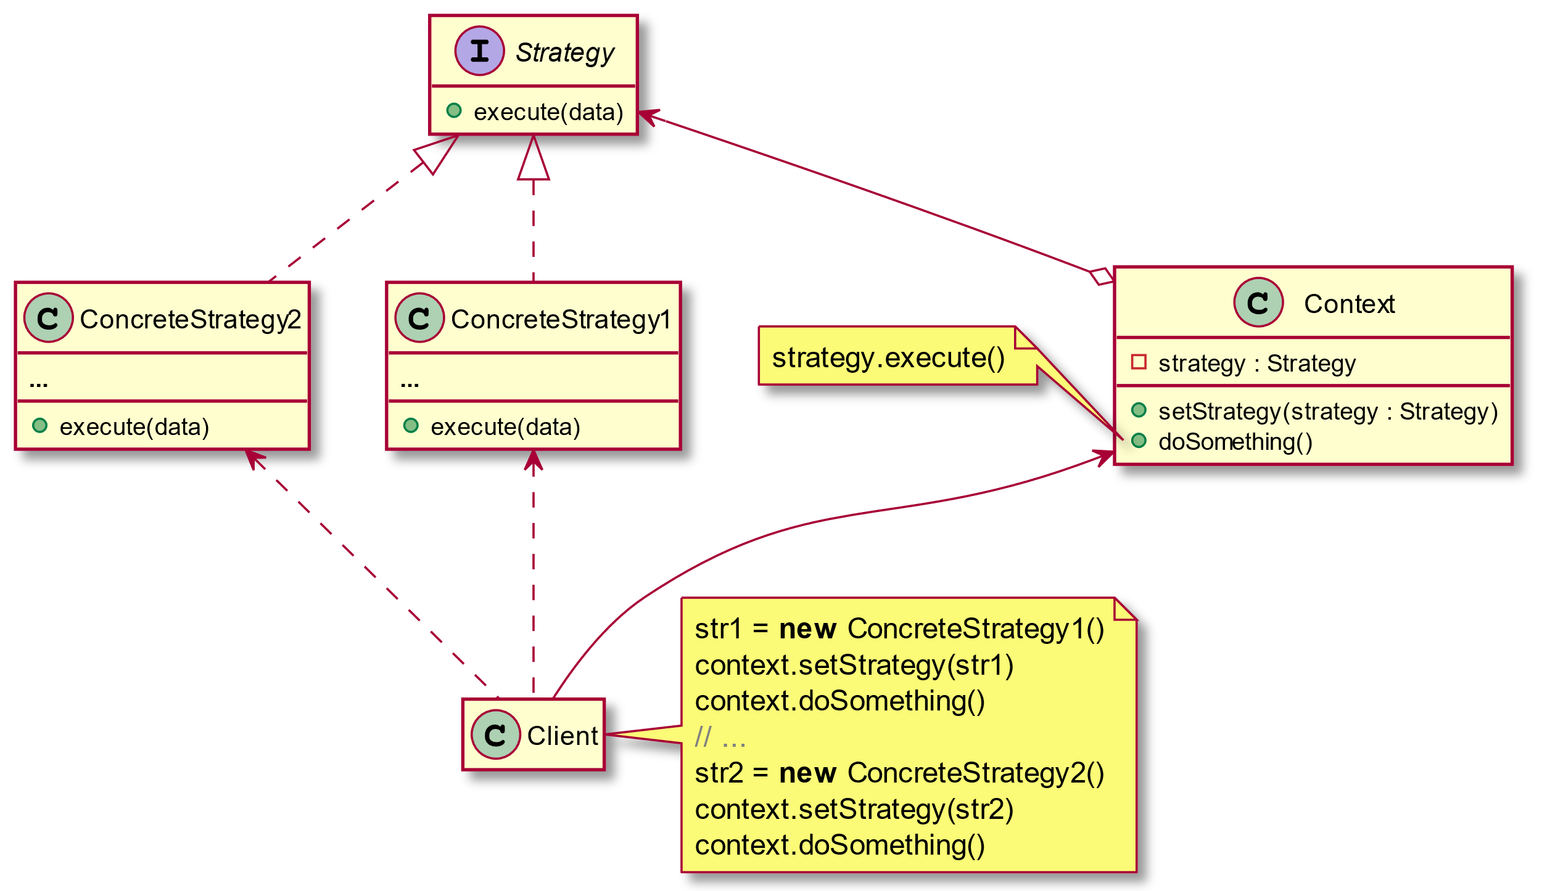

Slide 16
Strategy: Consequences
Greater flexibility, reuse.
Can change algorithms dynamically.
Strategy creation & communication overhead.
Inflexible Strategy interface.
Semantic incompatibility of multiple strategies used together.

Slide 17
Strategy: Examples
Strategy (refactoring.guru)
Strategy pattern – Wikipedia
Strategy Design Pattern in Java - Example Tutorial – JournalDev

Slide 18

State

Slide 19
State: Problem
An object should change its behavior when its internal state changes.
State-specific behavior should be defined independently. That is, adding new states should not affect the behavior of existing states.
Applicability
When an object must change its behavior at run-time depending on which state it is in.
When several operations have the same large multipart conditional structure that depends on the object's state.

Slide 20
State: Solution
Intent
Allow an object to alter its behavior when its internal state changes—the object will appear to change its class.
What solution does the State design pattern describe?
Define separate (state) objects that encapsulate state-specific behavior for each state. That is, define an interface (state) for performing state-specific behavior, and define classes that implement the interface for each state.
A class delegates state-specific behavior to its current state object instead of implementing state-specific behavior directly.

Slide 21
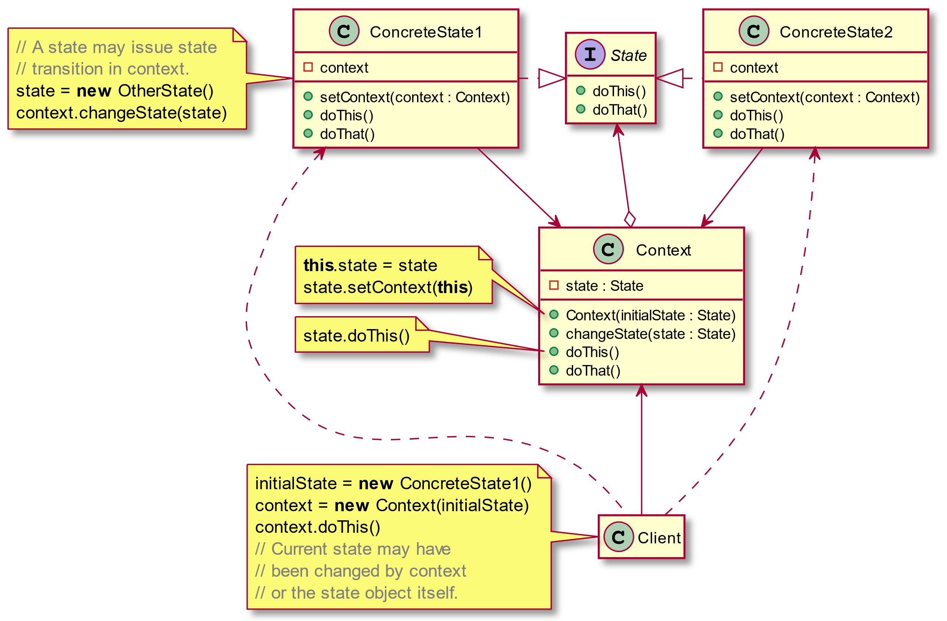

Slide 22
State: Consequences
It localizes state-specific behavior & partitions behavior for different states.
It makes state transitions explicit.
State objects can be shared.
Can result in lots of subclasses that are hard to understand.

Slide 23
State: Examples
State (refactoring.guru)
State pattern – Wikipedia
State Design Pattern in Java – JournalDev

Slide 24

Template Method

Slide 25
Template Method: Problem
How to define the overall structure of the operation in a base class, but allow subclasses to refine, or redefine, certain steps?
Applicability
Implement invariant aspects of an algorithm once & let subclasses define variant parts.
Localize common behavior in a class to increase code reuse.
Control subclass extensions.

Slide 26
Template Method: Solution
Intent
Provide a skeleton of an algorithm in a method, deferring some steps to subclasses.
This pattern has two main parts:
The "template method" is implemented as a method in a base class (usually an abstract class). This method contains code for the parts of the overall algorithm that are invariant. The template ensures that the overarching algorithm is always followed.
Subclasses of the base class "fill in" the empty or "variant" parts of the "template" with specific algorithms that vary from one subclass to another.

Slide 27
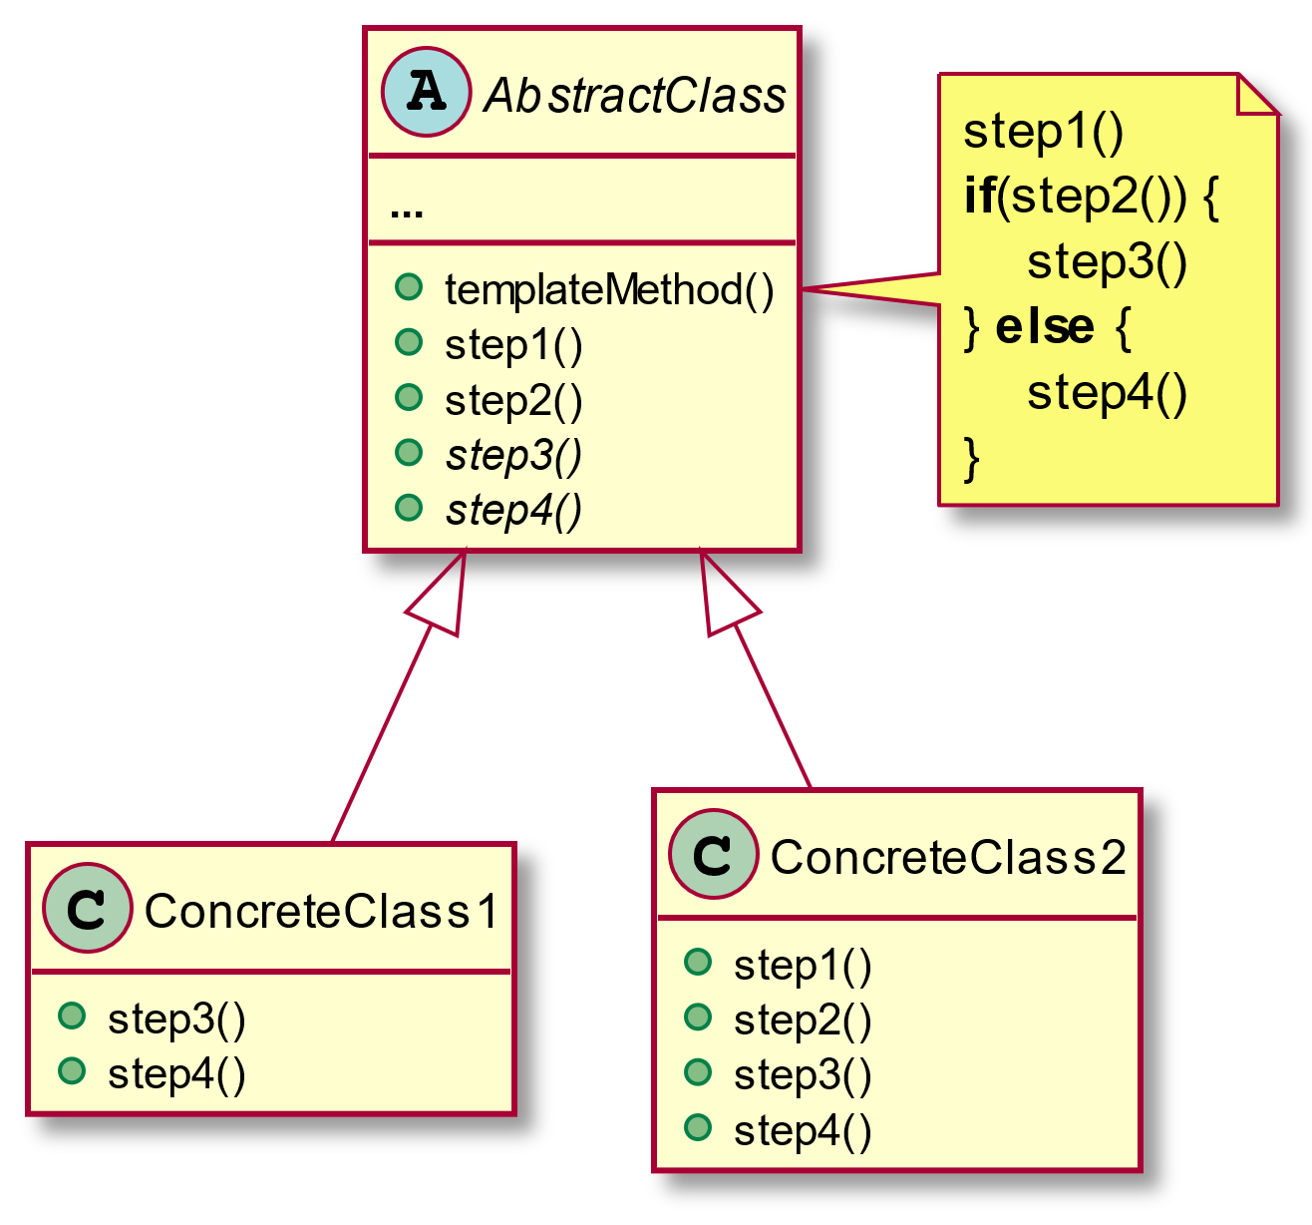

Slide 28
Template Method: Consequences
Leads to inversion of control (“Hollywood principle”: don't call us – we'll call you).
Promotes code reuse.
Lets you enforce overriding rules.
Must subclass to specialize behavior (cf. Strategy pattern).

Slide 29
Template Method: Examples
Template Method (refactoring.guru)
Template method pattern – Wikipedia
Template Method Design Pattern in Java – JournalDev

Slide 30

Visitor

Slide 31
Visitor: Problem
How to define a new operation for (some) classes of an object structure without changing the classes?
Applicability
When classes define many unrelated operations.
Class relationships of objects in the structure rarely change, but the operations on them change often.
Algorithms keep state that’s updated during traversal.

Slide 32
Visitor: Solution
Intent
Centralize operations on an object structure so that they can vary independently but still behave polymorphically.
What solution does the Visitor design pattern describe?
Define a separate (visitor) object that implements an operation to be performed on elements of an object structure.
Clients traverse the object structure and call a dispatching operation accept (visitor) on an element — that "dispatches" (delegates) the request to the "accepted visitor object". The visitor object then performs the operation on the element ("visits the element").

Slide 33
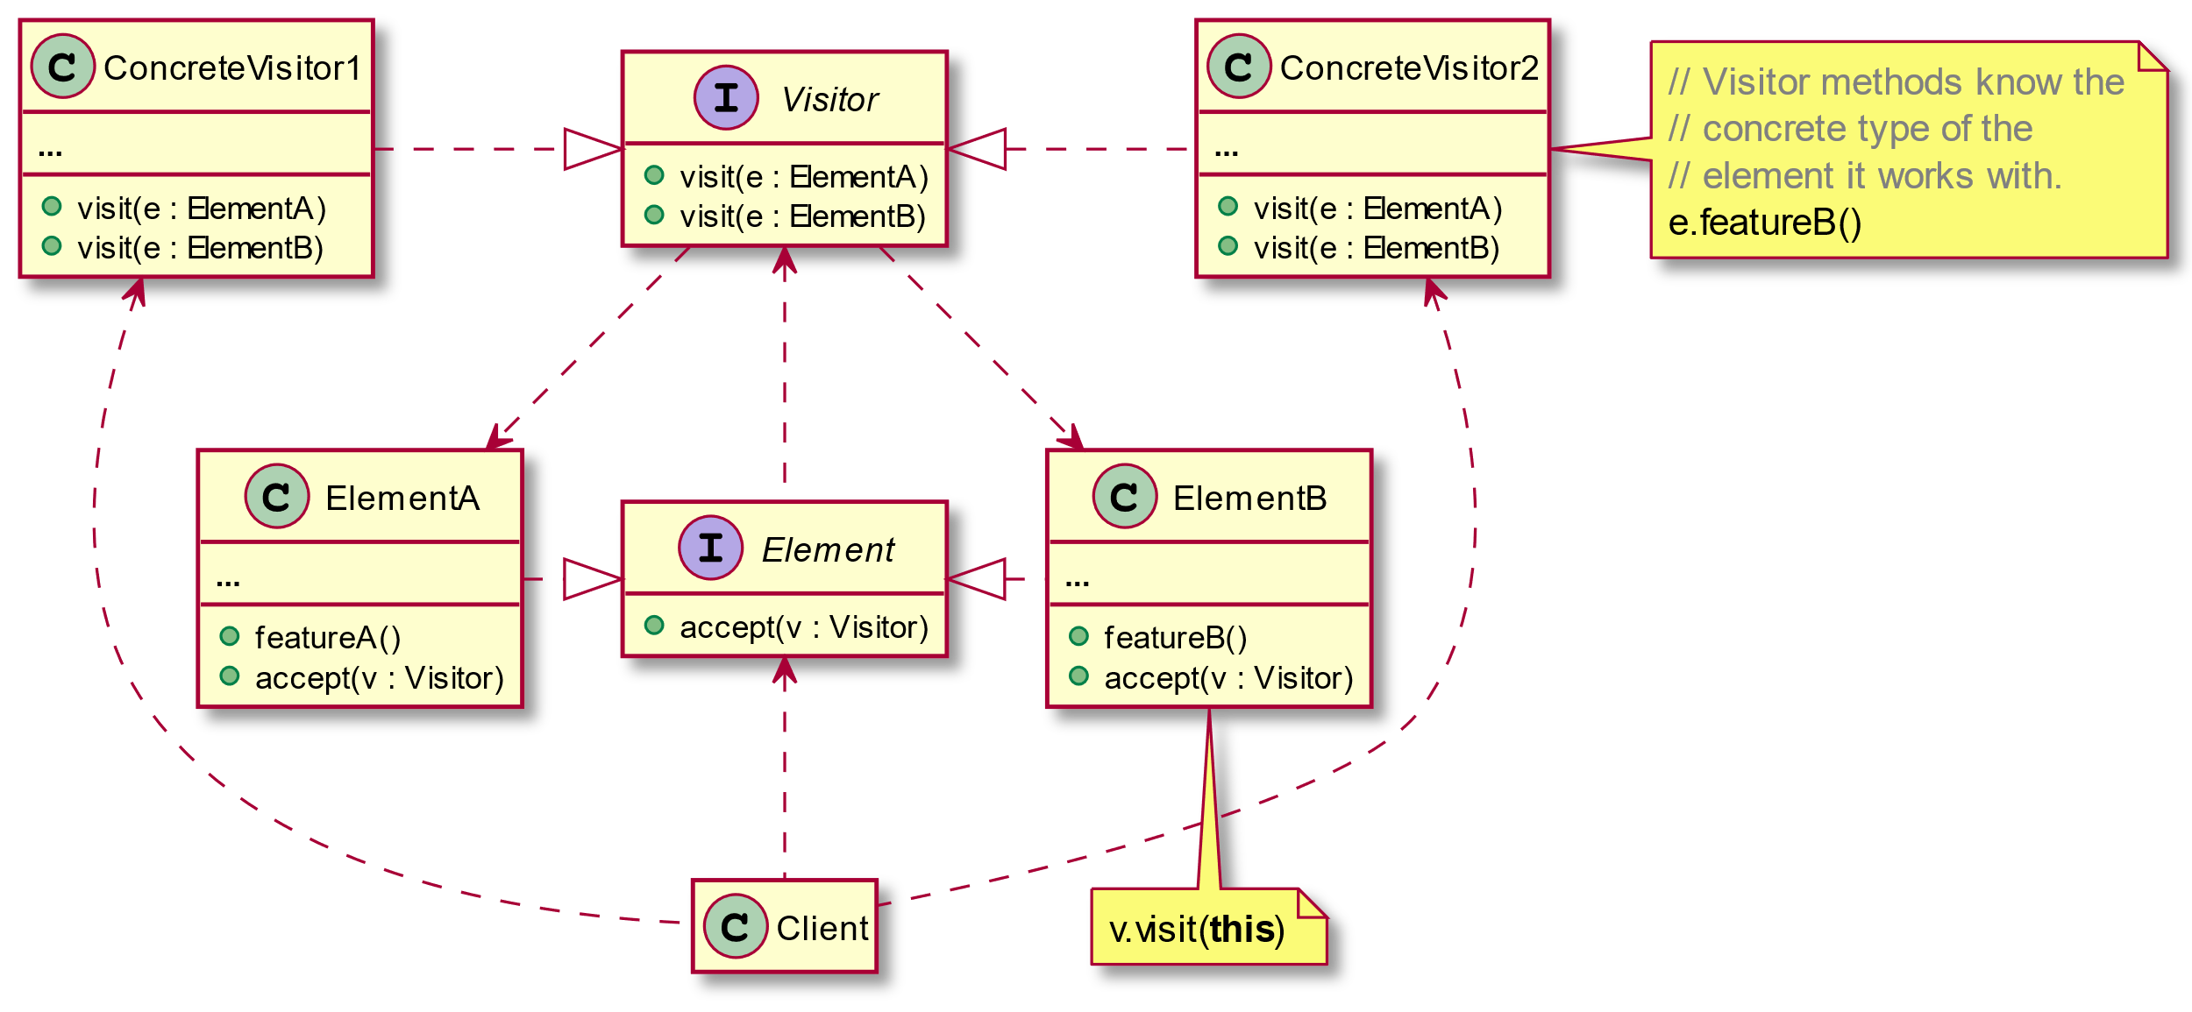

Slide 34
Visitor: Consequences
Flexibility: visitor algorithm(s) & object structure are independent.
Localized functionality in the visitor subclass instance.
Circular dependency between Visitor & Element interfaces.
Visitor brittle to new ConcreteElement classes.

Slide 35
Visitor: Examples
Visitor (refactoring.guru)
Visitor pattern – Wikipedia
Visitor Design Pattern in Java – JournalDev

